Slide 1














Project presentation
Presented by
Jingyu Tan & Haoze Mu

Slide 2

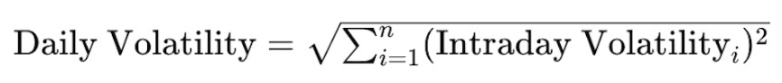
Origin of the creative idea
Use the stock price and volatility data, news data, EPS of Boeing Company (fundamental aspect), macroeconomic data like VIX, CPI, and so on to predict the volatility of daily stock price of Boeing Company.
Target variable:

Slide 3
Data Used
Provided:
Intraday price and volatility data
Collected:
Sentiment: news data from multiple sources
Fundamental: EPS
Macroeconomic: Fed Funds rate, 10y, 1y, 1m yields, CPI, VIX
Market: Boeing trading volume, Dow Jones Industrial Average, S&P Aerospace & Defense Select Industry Index, Crude oil price - Brent

Slide 4
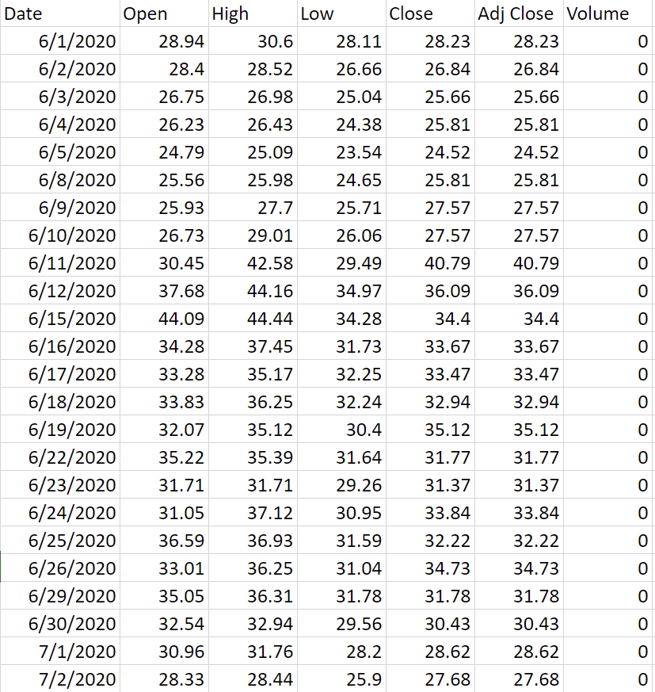
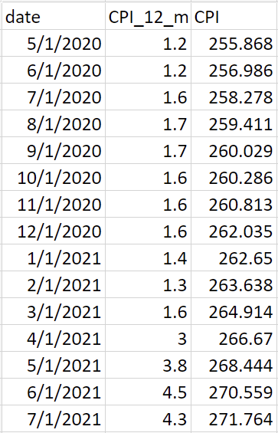
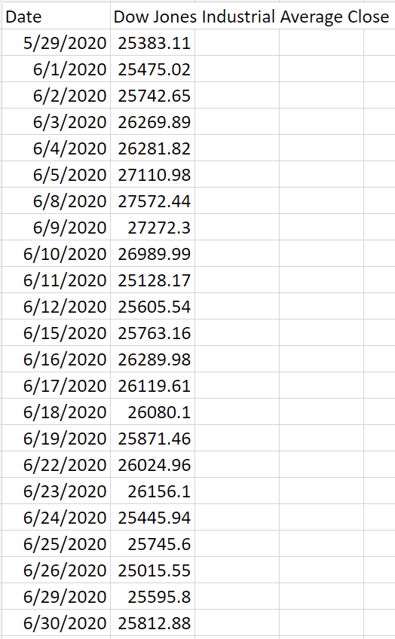
Collecting Data (Macroeconomics)
01. VIX
02. CPI
03. DJIA

Slide 5
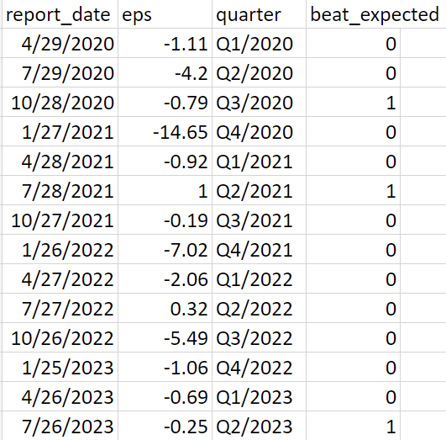
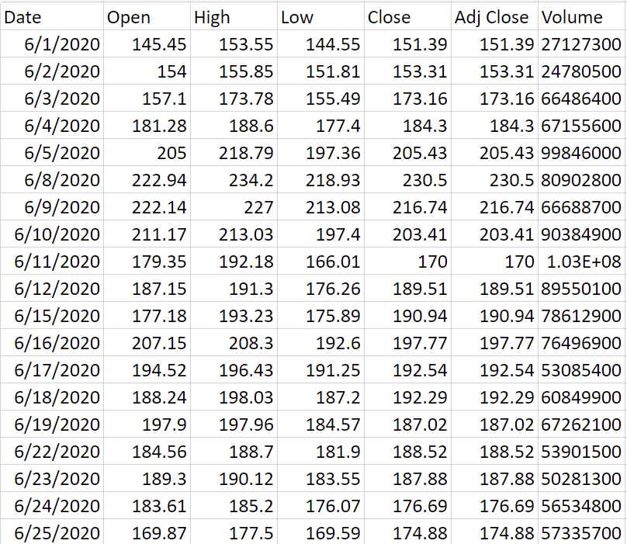
Collecting Data (Fundamental Aspects)
01. EPS
02. DAILY Volume

Slide 6
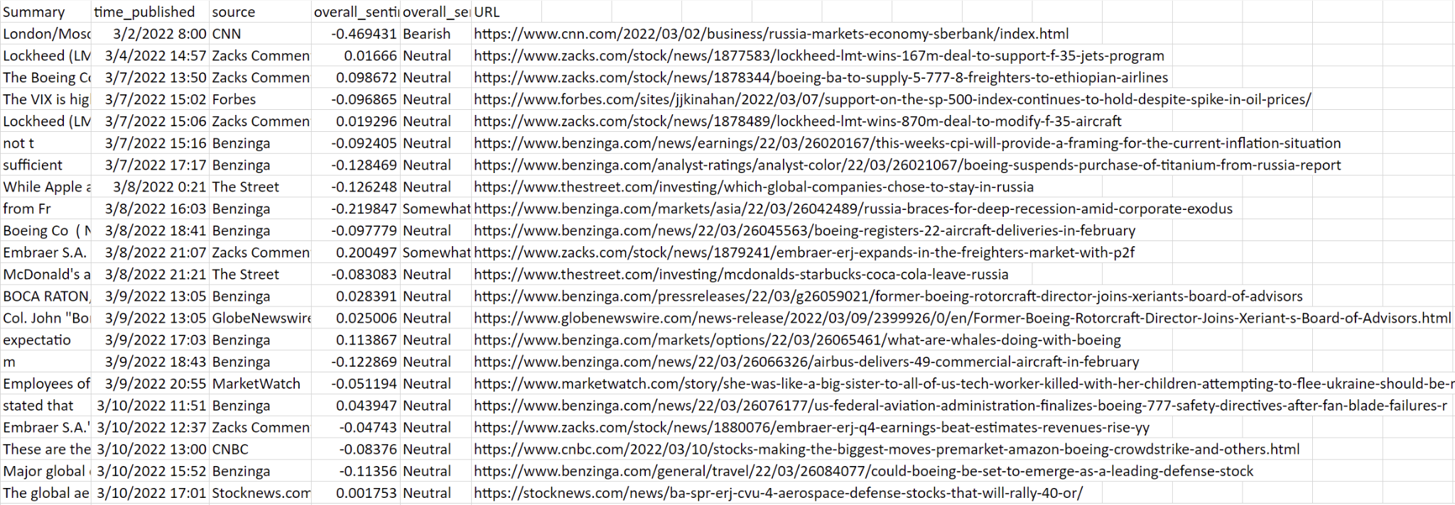
Collecting Data(Sentiment of News)
01. News related to Boeing

Slide 7
Data Preparation: Feature Engineering
Intraday
Transfer price data
1. Obtained the 5-min level data from the one second level price data, extracting the maximum, the minimum, the mean, and the last data points of every 5-min interval
2. From the 5-min level data, we created lags, daily returns, last hour's returns, short term returns to long term returns ratio, skewness and kurtosis of price and returns, etc.
Half hour level volatility data
Lags, daily volatility range, last hour's volatility, short term volatility to long term volatility ratio, skewness and kurtosis of volatility, etc.
News data
daily news count, sentiment score, daily news count after market hours, bearish, bullish, neutral proportion, etc.
Intraday → Daily

Slide 8
Data Preparation: Feature Engineering
Daily
Obtained percentage change, etc.
Frequency remains as is
Monthly/Quarterly
Monthly/Quarterly → Daily, through forward filling
Totaling 90+ features

Slide 9
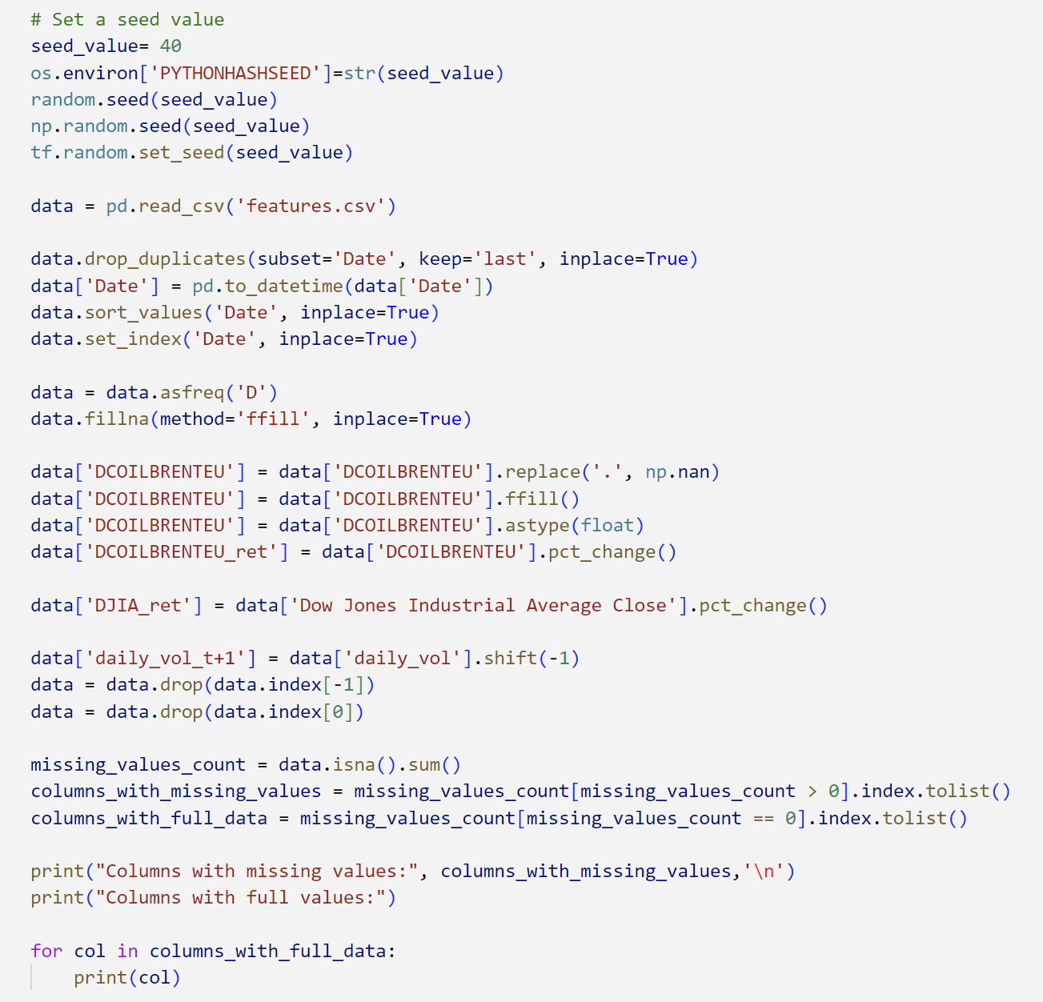
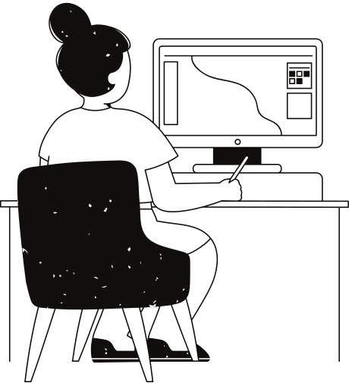
Data
Preparation for Model Fitting

Slide 10
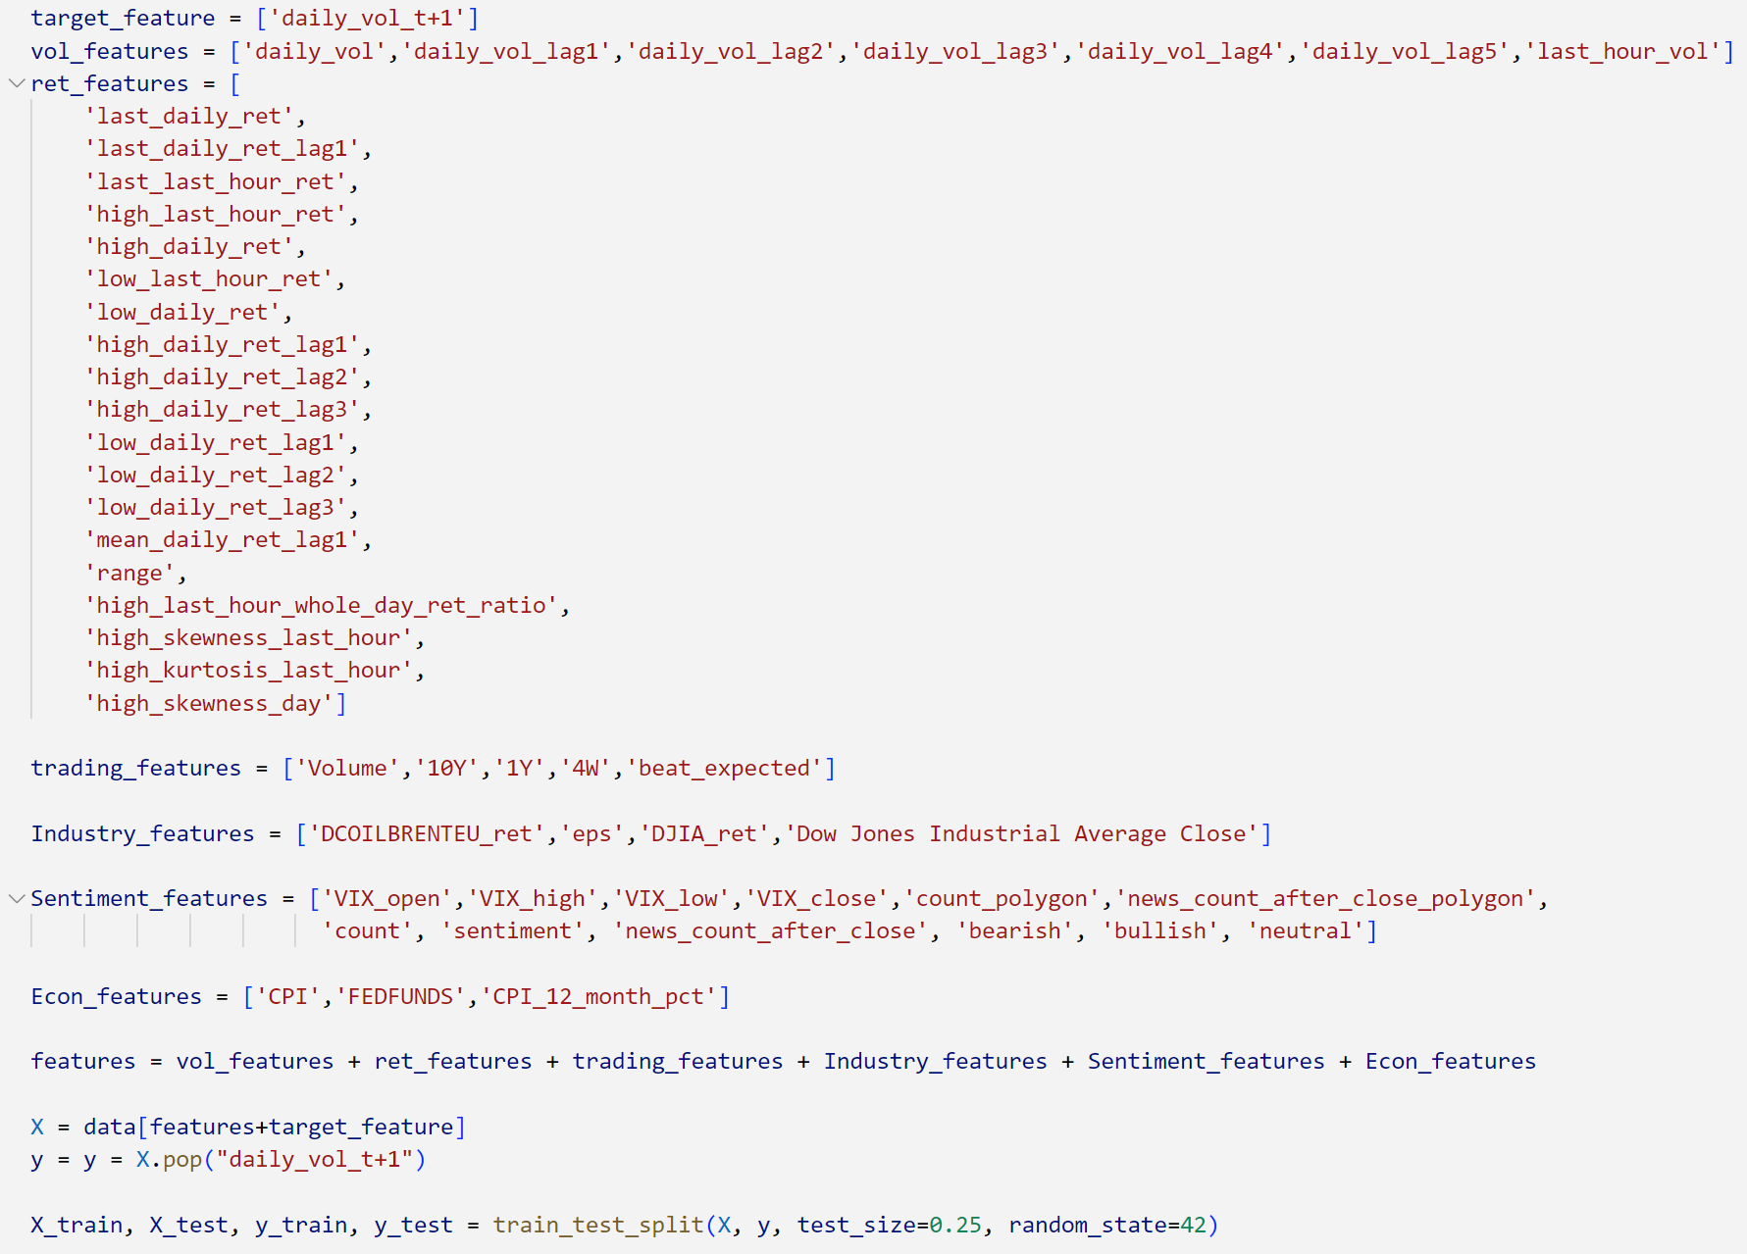

Data
Preparation
for Regression Tree

Slide 11
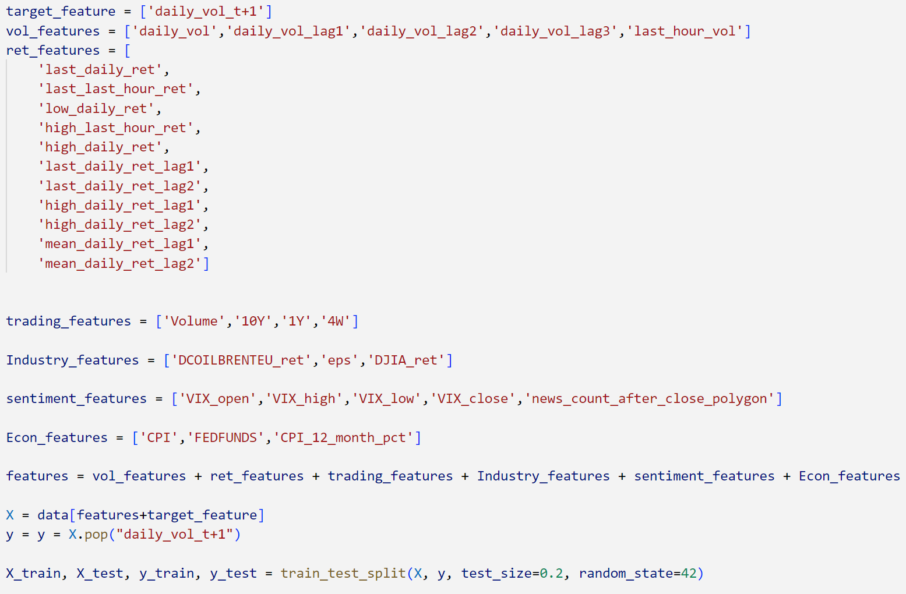
Data
Preparation
for Neural Network

Slide 12
Model Selection
01.
02.
03.
Regression Tree
XGBRegressor
Neural Network

Slide 13
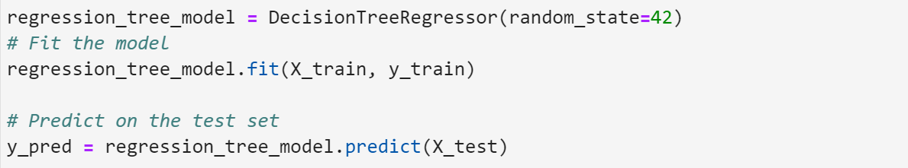
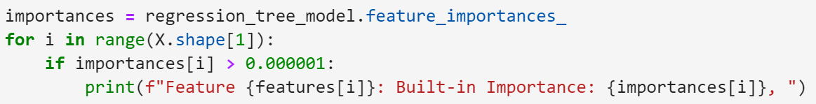
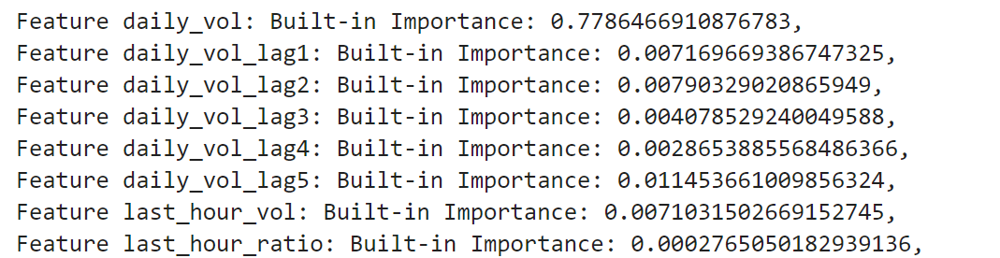
Regression Tree Model Fitting
Identify feature importances
···

Slide 14
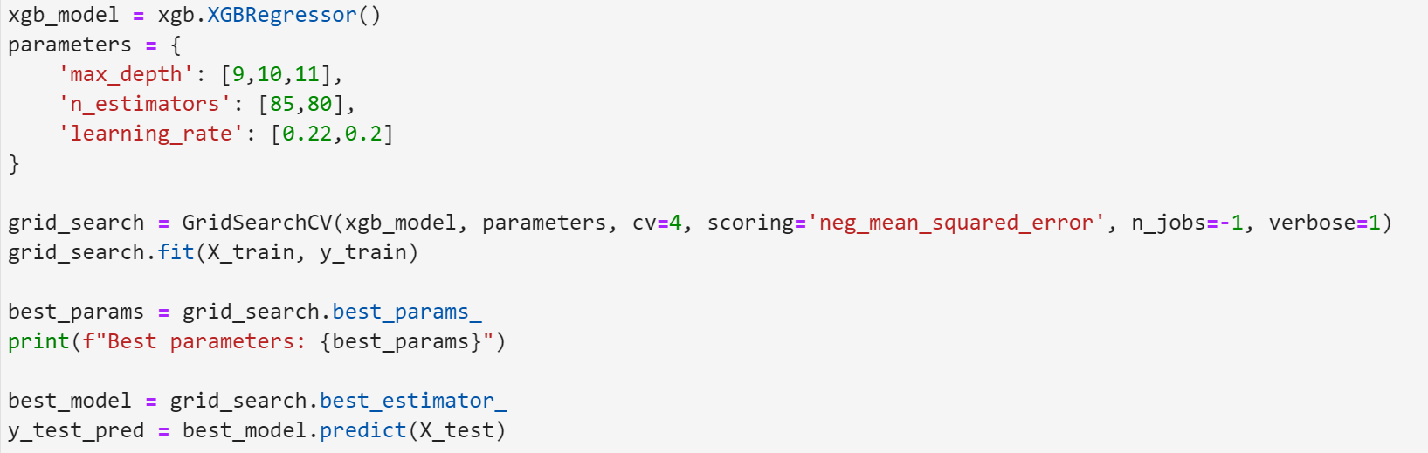
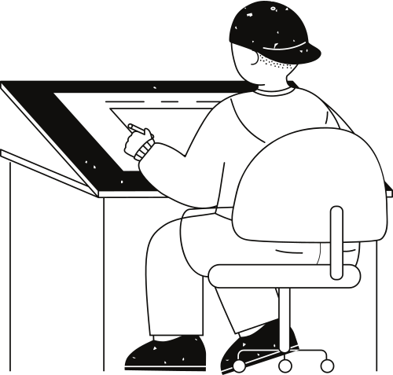
XGB Regressor Model Fitting

Slide 15
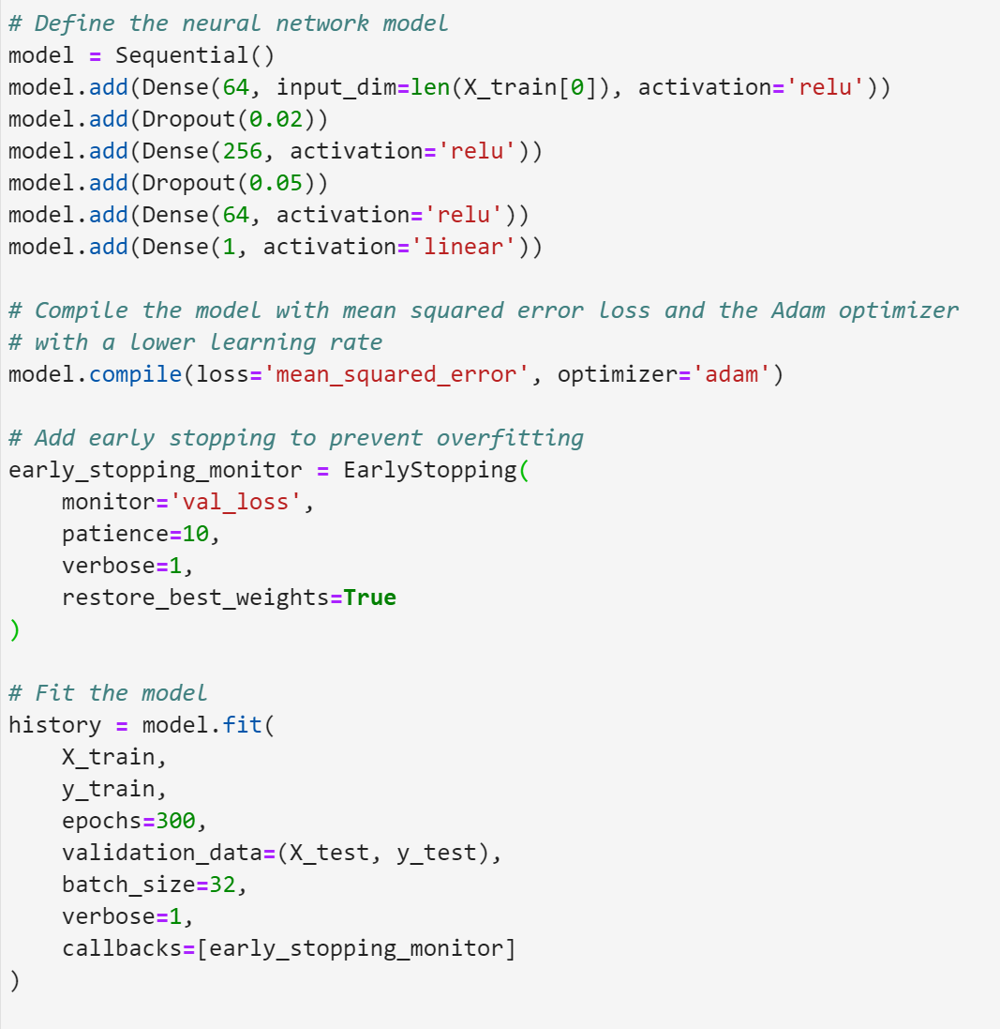

Neutral Network
Model Fitting

Slide 16
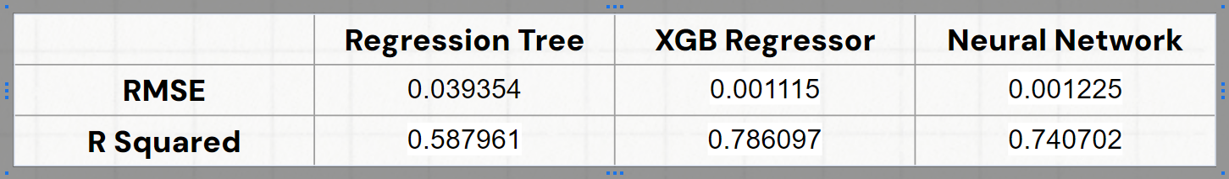
Model Evaluation
 | Regression Tree | XGB Regressor | Neural Network
RMSE | 0.039354 | 0.001115 | 0.001225
R Squared | 0.587961 | 0.786097 | 0.740702

Slide 17
Thank you very much!

Slide 18
Q&A

